Slide 1

Parse
A cloud-based service that provides everything you need to build an app

Slide 2
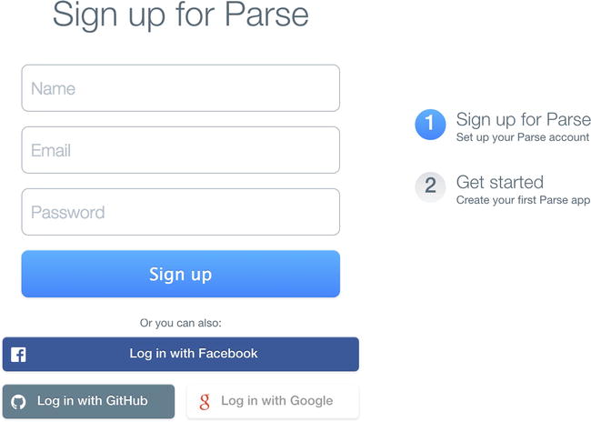
First thing first
Create an account at parse.com
Notes:
After logging in, you will have the option to create a new Parse app. You can also visit parse.com/apps to create and manage Parse applications. This is where you access each of your application's settings and details, such as Analytics and Cloud Code.

Slide 3
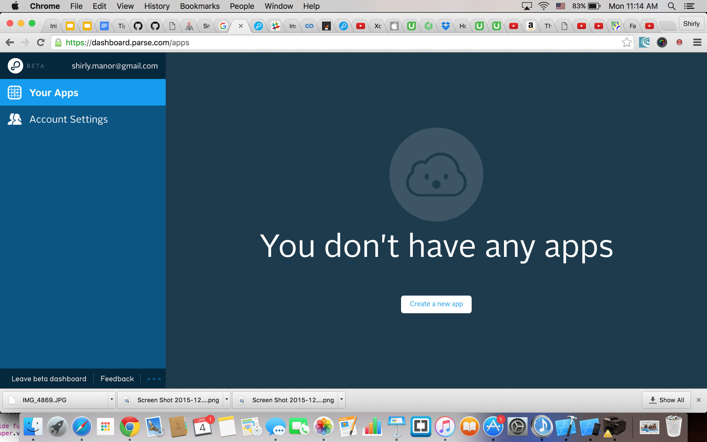
Let’s meet here
Notes:
Now let’s creat our first App and our first class.Select "Custom" and provide an appropriate class name. Remember - a "class" is analogous to a table name.

Slide 4
Let’s play with XCode!
Download parse SDK
Open XCode
Create a new Single View application and remember to select Swift as the development language.
Add new group (directory) call it Frameworks
Drag and drop all the files from the parse-library to our frameworks directory.
click on the project title to view the project settings. On the General tab, at the bottom, you'll see a section titled "Linked Frameworks and Libraries" - click the + button.

Slide 5
Meet me after adding the following:
AudioToolbox.framework
CFNetwork.framework
CoreGraphics.framework
CoreLocation.framework
QuartzCore.framework
Security.framework
StoreKit.framework
SystemConfiguration.framework
libz.tbd
libsqlite3.tbd
Notes:
Note: This is a comprehensive list of dependencies for a typical app. You may be able to omit some of these if you are not using the -ObjC linker flag or if you do not plan to implement Location Services or In-App Purchases, for example.

Slide 6
Install the frameworks with pod
First time install cocopad ->open terminal
sudo gem install cocopods
go to your project directory and write pod init
open podfile :uncomment the line and add pod ‘Parse’
In the terminal - pod install
Now let’s open the workespace!
Notes:
Dependency tool for swift and objective-c projects.we will not need to check for new versions.

Slide 7
Let’s connect our App to Parse
Open Parse Doc and add code to AppDelegate.swift
Add Import Parse and Import Bolt
Add the keys
Now let’s test it
Add button
Add code
Working!! Yeah!!

Slide 8
Retrieve our Data from Parse
Go to Doc -> IOS -> Guide and find retrieving-objects

